Slide 1
Extension Activities (2021-22)
Activities | No. of programmes | No. of farmers | No. of Extension Personnel | TOTAL
Advisory Services | 106 | 18780 | 932 | 19712
Field Day | 11 | 478 | 14 | 492
Group discussions | 02 | 84 | 04 | 88
Kisan Ghosthi | 10 | 746 | 12 | 758
Film Show | 166 | 692 | 182 | 774
Self -help groups | 07 | 112 | 00 | 112
Exhibition | 01 | Not fixed | Not fixed | Not fixed
Scientists' visit to farmers field | 78 | 2239 | 56 | 2295
Kisan Mela (Bangalore Virtual) | 01 | 74 | 04 | 78
Kisan Club (TTC) | 07 | 189 | 06 | 195
Ex-trainees Sammelan | 01 | 23 | 00 | 23
Farmers' workshop/Seminar | 16 | 829 | 31 | 860
Method Demonstrations | 05 | 103 | 03 | 106
Celebration of important days | 09 | 744 | 53 | 797
Special day celebration | 14 | 1095 | 55 | 1150
Exposure visits | 06 | 375 | 00 | 375
Total

Slide 2
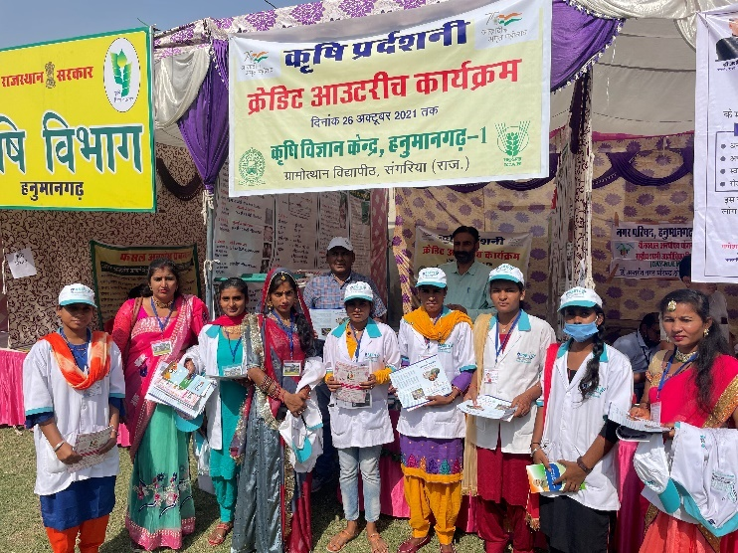
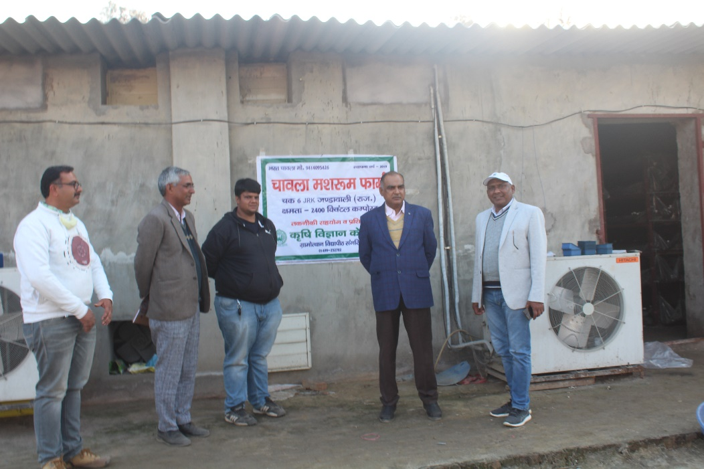
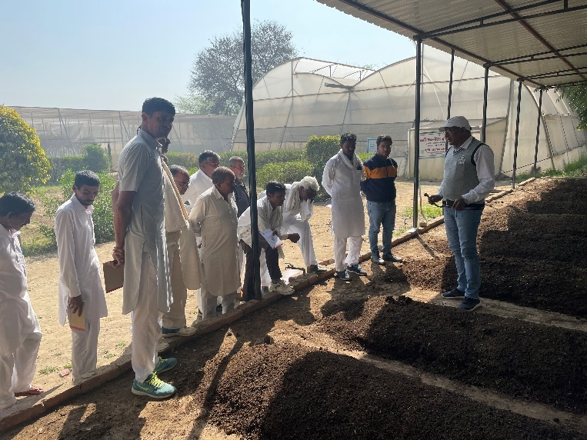
Other Extension activities (2021-22)
Activities | Number
Extension Literature | 08
News paper coverage | 164
Popular articles | 16
Radio Talks | 45
TV Talks | 2
Animal health camps (Number of animals treated) | 0
Total | 235

Slide 3
Soil & Water Sample analysis
S.No. | Type of Sample | No. of Samples | Soil health card/Reports distributed
1. | Orchard Soil Sample | 1372 | 231
2. | Soil Sample | 971 | 855
3. | Water Sample | 867 | 730
 | Total Samples | 3210 | 1798
Plant Health Clinic
S.No. | Type of Sample | No. of Samples
1 | Entomology | 136
2 | Plant Pathology | 122
 | Total | 258
Production of bio agents
Products | Name of the bio-product | Quantity (kg)
Bio-fungicide | T. harzinium | 530
Compost | Vermi compost | 1652
Worms | Eisenia fetida | 549
Azolla | Azolla pinnata | 175

Slide 4
SEED PRODUCTION AT KVK
S. No. | Crop | Varieties | Quantity (Q)
1 | Wheat | HD-3117, HD-3086, HD-3226 | 86.00
2 | Chickpea | GNG-2171 | 09.60
3 | Mustard | RH 0749 & RH-725 | 10.90
4 | Til | RT-351 | 0.31
5 | Moong | MH-421 | 2.20
Provided seed to farmers : 294
Amount : Rs. 5.00 lacs
STATUS REVOLVING FUND
Year | Opening balance as on 1st April | Income during the year | Expenditure during the year | Net balance in hand as on 1st April of each year
2018-19 | 2301576.12 | 4214994.77 | 3927079.78 | 2566978.31
2019-20 | 2566978.31 | 4842108.09 | 2744539.29 | 4510892.36
2020-21 | 4510892.36 | 5009066.50 | 3520336.10 | 5791236.12
2021-22 | 5791236.17 | 6593674.98 | 4099745.36 | 8467225.13

