Slide 1
Frontline Demonstrations
S. No. | Enterprise/ Crop | No. of Demon. | Area (ha)/Units
1. | Pulses
 | Mungbean (CFLD) | 50 | 20
 | Chickpea (CFLD) | 50 | 20
 | IPM in Chickpea | 10 | 04
2. | Oilseeds
 | Sesame (CFLD) | 25 | 10
 | Mustard (CFLD) | 50 | 20
3. | Horticultural crops
 | Broccoli | 10 | 0.5
4. | FLD on other enterprises
 | Disease Management | 50 | 50
 | Nutrient Management | 10 | 10
 | Composite fish culture | 10 | 2.5
5. | Vegetables (Kitchen Gardening) | 20 | 0.6

Slide 2
Cluster Front Line Demonstration of Mungbean (NFSM) (Kharif-2021)
Crop – Mungbean
Variety – MH 421
Local check – SML 668
Area–20 ha
Demonstration-50
Crop Sequence:- Mungbean-Mustard; Mungbean–Wheat; Mungbean–Chickpea; Mungbean – Barley
Cultivation under irrigated conditions.
Soil type:- Sandy loam soil; Organic matter - 0.2 to 0.3% (Low); Phosphorus - 20 to 32 kg/ha (Medium) & Potash - 390 to 495 kg/ha (high)
Weed flora : Digera arvensis (Tandla), Trianthema monogyna (Itsit), Cyperus rotundus (Motha) and Cynodon dactylon (Doob)
Major insects : Whitefly & Pod borer.
Major diseases : Bacterial leaf spot & Cercospora leaf spot.
Technological package demonstrated:-
Time of sowing:- First fortnight of July
Recommended seed rate & spacing:- 16 kg per hectare & 30 cm
Seed treatment:- Carbendazim 35 SD @ 2 g per kg of seed & Imidachloprid 48% FS @ 5 ml per kg of seed
Soil treatment :- Trichoderma harzianum @ 5 kg per hectare.
Basal application of fertilizers: - 20 kg N & 40 kg P₂O₅ per hectare
Use of bio inoculants:- NPK Consortia @ 2.5 lit/ha as soil application before sowing.
Use of herbicide:- Imazethapyr 10% SL @ 40 gram a.i. per hectare in 400-500 litre water (Post emergence).
Use of PP measures :- Cotto 12 @ 1 ml/l water for white fly and DAMAN A 47 @ 1 ml/l water for pod borer

Slide 3
Performance of CFLD Mungbean (Kharif-2021)
State average yield : 5.59 q/h (2019-20)
District average yield : 3.85 (2019-20) q/h
Yield (q/ha) |  |  |  | % Increase in yield
High. | Min. | Av. | Local check
14.60 | 7.90 | 9.52 | 7.62 | 24.93
Sale price : Rs.6500/- per qtls Minimum Support Price (MSP) : Rs. 7275/- per qtls (Kharif 2021)
Economics
 | Demonstration Plot | Farmer's Existing Plot
Gross Cost (Rs/ha) | 18748.00 | 16436.00
Gross Return(Rs/ha) | 61880.00 | 49530.00
Net Return (Rs/ha) | 43132.00 | 33094.00
B:C Ratio | 3.30 | 3.01
Technological gap analysis of CFLDs mungbean
Number of CFLDs | Potential yield (q/ha) | Demon yield (q/ha) | Farmer Practice yield (q/ha) | % increased | Ext. Gap (q/ha) | Tech. Gap (q/ha) | Tech. Index (%)
50 | 16 | 9.52 | 7.62 | 24.93 | 1.9 | 6.48 | 40.5

Slide 4
About technology interventions
Due to the least incidence of moong yellow mosaic virus disease and higher yield performance in comparison to the check, about 57 percent farmers accept the variety and interventions of demonstrated technologies.
In the Moong crop, Digeria arvensis is a prominent weed, which emerges after the first irrigation or rainfall. Therefore, post-emergence herbicides are more effective than pre-emergence herbicides. Hence the use of Imazethapyr 10% SL @ 40 gm a.i. per hectare in 400-500 litre water has been found effective.
The use of Trichoderma harzianum not only caused the suppression of various diseases that were caused by fungal pathogens and also enhanced plant growth, leading to increased yield and quality.
During the demonstration, it was observed that bio pesticides (Cotto 12 @ 1ml/litre of water and DAMAN A 47 @ 1ml/litre of water) were more effective against white fly and pod borer.

Slide 5
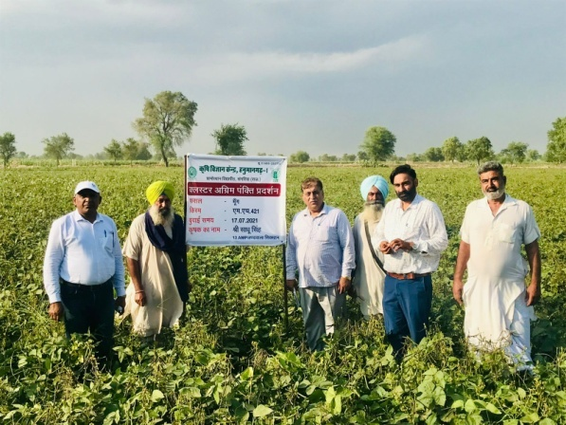
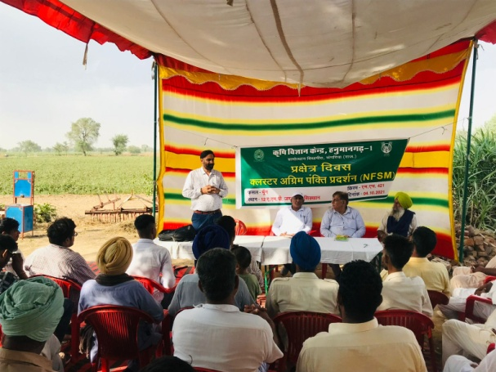
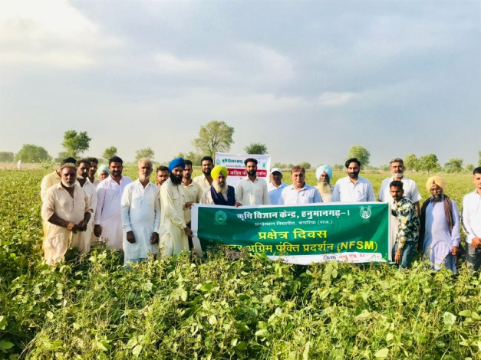
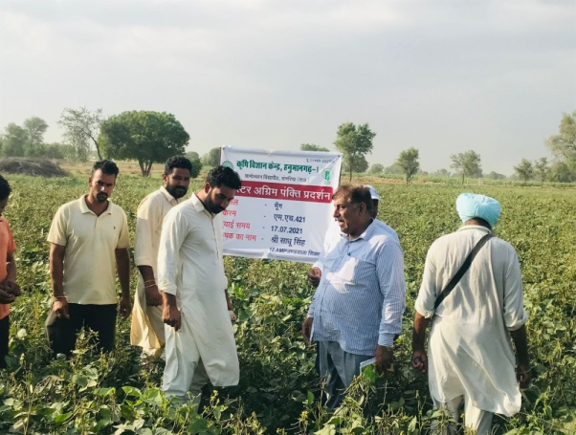
Field activities under CFLD Mungbean:-
Field Activities Organized | Date and Place of Activity | No. of Farmers Attended
Field day (Moong) | 01.10.2021 and 1 MST, Masitawali | 21
Field day (Moong) | 04.10.2021 and 12 AMP, Jandawala sikhan | 32
Farmer’s feedback:-.
Good response of the variety (MH 421).
Good response of basal application of fertilizers & bio pesticide.
Technical feedback:-.
Need of varieties, having tolerance or resistance to yellow mosaic virus and suitable for rain fed areas.
Need of research on bio pesticides to control white fly & pod borer

Slide 6
Cluster Front Line Demonstration of Sesame (NFSM) (Kharif-2021)
Crop – Sesame
Variety – RT 351
Local check – RT 46
Area–10 ha
Demonstration-25
Crop Sequence:- Sesame-Wheat; Sesame–Mustard
Cultivation under irrigated conditions.
Soil type:- Sandy loam soil; Organic matter - 0.2 to 0.3% (Low); Phosphorus - 20 to 32 kg/ha (Medium) & Potash - 390 to 495 kg/ha (high)
Weed flora : Digera arvensis (Tandla), Cyperus rotundus (Purple nutsedge), Cyperus iria (Umbrella sedge), Eleusine indica (Indian Goosegrass)
Major insects : White fly & Jassids.
Major diseases : Phyllody, Bacterial leaf spot & Alternaria leaf spot.
Technological package demonstrated:-
Spacing: 30 X 10-15 cm.
Recommended seed rate:- 2.5 kg per hectare
Seed treatment :- Carbendazim 35 SD @ 2 g per kg of seed & Imidachloprid 48% FS @ 7 ml per kg of seed
Time of sowing:- July month
Balance use of fertilizers: - 20 kg N₂ + 20 kg P₂O₅ + 14 kg S (through SSP) per hectare as basal and 20 kg N as top dressing at 30-35 DAS.
Use of bio inoculant: - NPK consortia @ 2.5 lit/ha.
Weed management: - Hand weeding
Use of PP measures :- Two spray of Thiamethoxam 25 WG @ 0.4g per litre of water at 45 & 60 DAS and 3rd spray of Streptocycline (150 ppm) + Blue copper (Copper oxychloride 50 WP) @ 2gm per litre of water at 70 DAS

Slide 7
Performance of CFLD Sesame (Kharif-2021)
State average yield : 3.27 q/h (2019-20)
District average yield : 3.27 (2019-20) q/h
Yield (q/ha) |  |  |  | % Increase in yield
High. | Min. | Av. | Local check
10.60 | 6.80 | 8.85 | 6.32 | 40.03
Sale price : Rs.10000/- per qtls Minimum Support Price (MSP) : Rs. 7307/- per qtls (Kharif 2021)
Economics
 | Demonstration Plot | Farmer's Existing Plot
Gross Cost (Rs/ha) | 22781.00 | 19300.00
Gross Return(Rs/ha) | 88500.00 | 63200.00
Net Return (Rs/ha) | 65719.00 | 43900.00
B:C Ratio | 3.88 | 3.22
Technological gap analysis of CFLDs Sesame
Number of CFLDs | Potential yield (q/ha) | Demon yield (q/ha) | Farmer Practice yield (q/ha) | % increased | Ext. Gap (q/ha) | Tech. Gap (q/ha) | Tech. Index (%)
25 | 12 | 8.85 | 6.32 | 40.03 | 2.53 | 3.15 | 26.25

Slide 8
About technology interventions
Performance of the variety (RT-351) in terms of yield has been better in demonstration plots.
Use of Thiamethoxam 25 WG @ 0.4g/lit resulted in good control of Whitefly as well as Jassids.
Although the farmers were advised to do hand weeding, but in the fields where Cyperus rotundus (Purple nutsedge), Cyperus iria (Umbrella sedge), Cynodon dectylon (Doob ghas) etc. weeds were appeared, the farmers sprayed Quizalofop Ethyl 5% at the rate of 500 gm per hectare, then good control was seen on the above weeds. But hand weeding was more effective in fields where Digera arvensis (Tandla) weed, was present.
Incidence of phyllody disease was reported in early sown sesame crop.

Slide 9
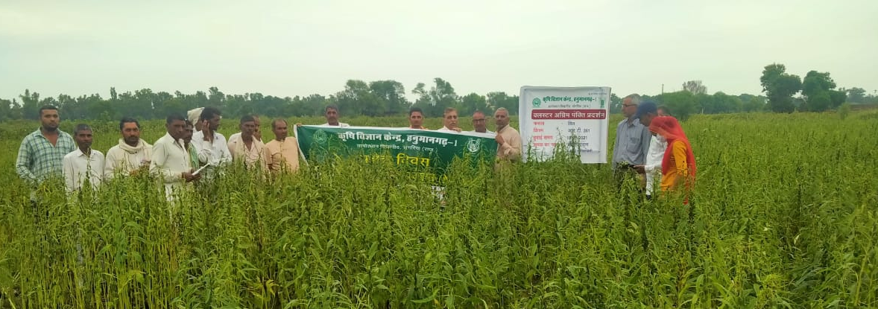
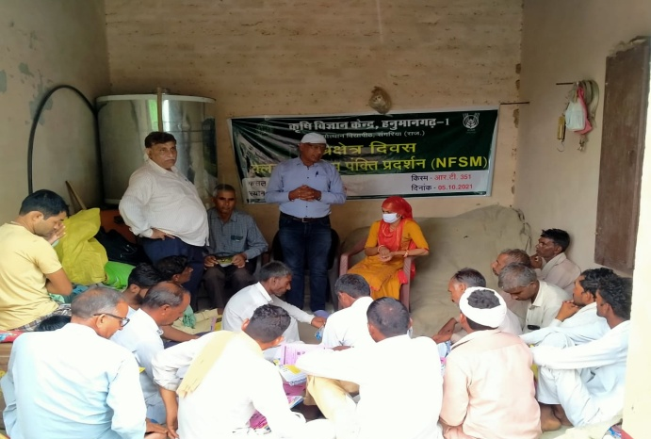
Extension & other activities under CFLD (Sesame) conducted:
Field days (1) : 32 participants
Field visit (5) : 78 participants
Media coverage (1) : Not fixed
Framer’s reactions:-.
Farmers were satisfied with the performance of RT-351 variety of sesame in reference of seed yield.
Good response of balance fertilizers & other inputs.
Technical feedback:-.
Development of phyllody resistant varieties of sesame.
Need for research on planting space in sesame crop.
Evaluation of some effective herbicides to control of weeds in sesame.

Slide 10
Cluster Front Line Demonstration of Chickpea (NFSM) (Rabi-2021-22)
Crop – Chickpea
Variety – GNG 2171
Local check – GNG 663
Area–20 ha
Demonstration-50
Crop Sequence:- Clusterbean-Chickpea; Fallow–Chichpea; Mungbean–Chickpea; Cotton–Chickpea.
Cultivation under irrigated conditions.
Soil type:- Sandy loam soil; Organic matter - 0.2 to 0.4% (Low); Phosphorus - 20 to 32 kg/ha (Medium) & Potash - 380 to 480 kg/ha (high)
Weed flora : Chenopodium album, Chenopodium murale, Asphodelus tenuifolius, Anagallis arvensis, Convolvulus arvensis.
Major insects : Helicoverpa armigera
Major diseases : Root rot & Ascochyta blight.
Technological package demonstrated:-
Soil treatment:- Trichoderma harziaum @ 5 kg per hectare
Time of sowing:- 20 October to 15 November
Seed rate & row spacing:- 60 kg per hectare & 30 cm
Seed treatment :- Carbendazim 50 WP @ 1.5 g per kg of seed, Imidachloprid 600 FS @ 5 ml per kg of seed.
Basal application of fertilizers: - 20 kg N₂ & 40 kg P₂O₅ per hectare
Weedicide :- Pendimethalin 38.7% CS @ 750ml a.i. per hectare.
Use of bio inoculant: - NPK consortia @ 2.5 lit/ha.
Use of PP measures (Pod borer):- Spray of Emamectin Banzoate 5% SG @ 0.5g/litre of water and Spinosad 45% SC @ 0.33ml/litre of water

Slide 11
Performance of CFLD Chickpea (Rabi-2021)
State average yield : 10.80 q/h (2019-20)
District average yield : 6.62 (2019-20) q/h
Yield (q/ha) |  |  |  | % Increase in yield
High. | Min. | Av. | Local check
17.40 | 12.80 | 14.92 | 12.61 | 18.32
Sale price : Rs.4500-4800 per qtl; Sale price of straw : Rs 150 per qtl. Minimum Support Price (MSP) : Rs. 5230/- per qtl (Rabi 2021-22)
Economics
 | Demonstration Plot | Farmer's Existing Plot
Gross Cost (Rs/ha) | 30400 | 27497
Gross Return(Rs/ha) | 71616 | 60528
Net Return (Rs/ha) | 41216 | 33031
B:C Ratio | 2.36 | 2.20
Technological gap analysis of CFLDs Chickpea
Number of CFLDs | Potential yield (q/ha) | Demon yield (q/ha) | Farmer Practice yield (q/ha) | % increased | Ext. Gap (q/ha) | Tech. Gap (q/ha) | Tech. Index (%)
50 | 24 | 14.92 | 12.61 | 18.32 | 2.31 | 9.08 | 37.83

Slide 12
About technology interventions
Performance of the variety (GNG-2171) in terms of yield has been better in demonstration plots.
Soil treatment with Trichoderma harziaum @ 5 kg per hectare, the damage from root rot disease was observed to be negligible.
Pre-emergence application of Pendimethaline 38.7% CS followed by one hand weeding at 30 DAS resulted in good control of broad-leaved weeds as well as other weeds. Because, Asphodelus tenuifolius (Pyaji) is not being properly controlled even after using the recommended weedicides.
There were heat wave conditions in the last week of March and the month of April. The temperature was recorded up to 4-5⁰C above normal temperature. At the stage of pod formation and grain filling in the gram crop, if the temperature is 35⁰C or more, the yield of the gram crop is affected. Therefore, there was an adverse effect on the gram yield.

Slide 13
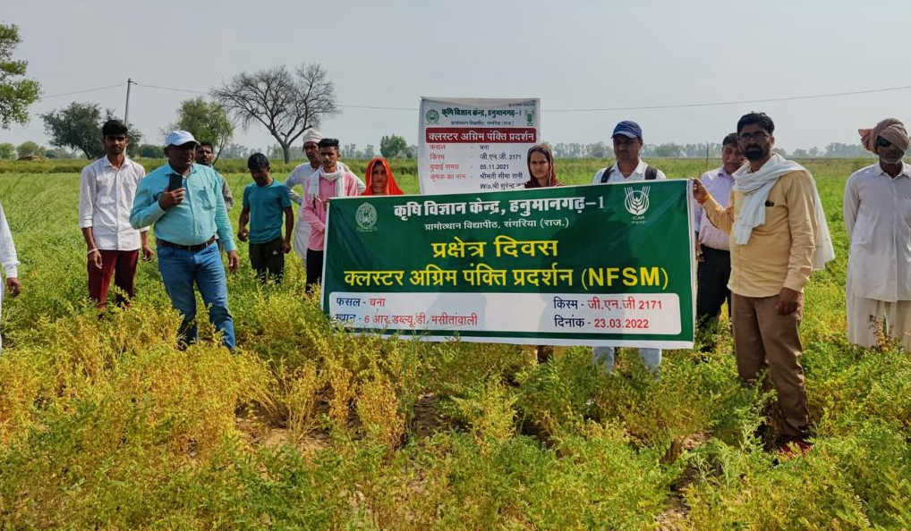
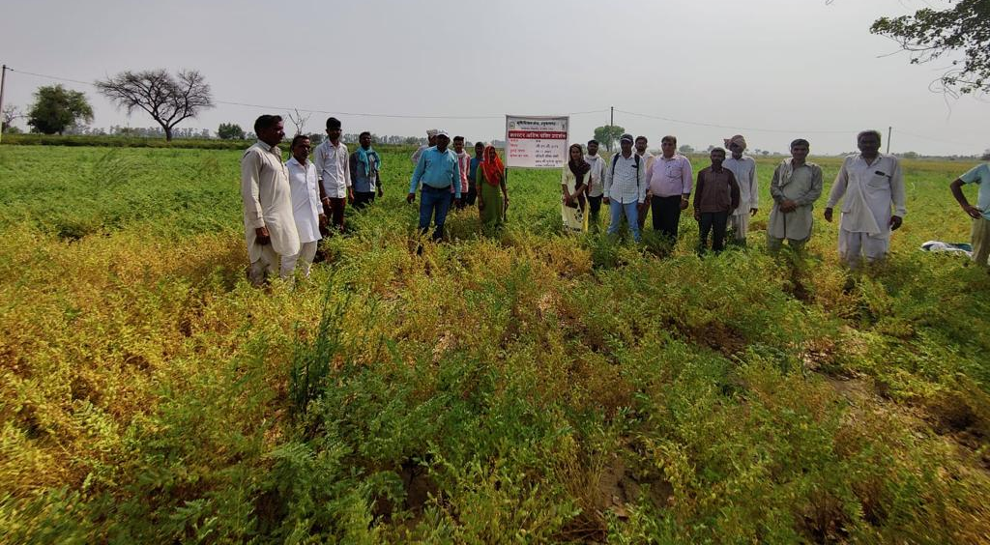
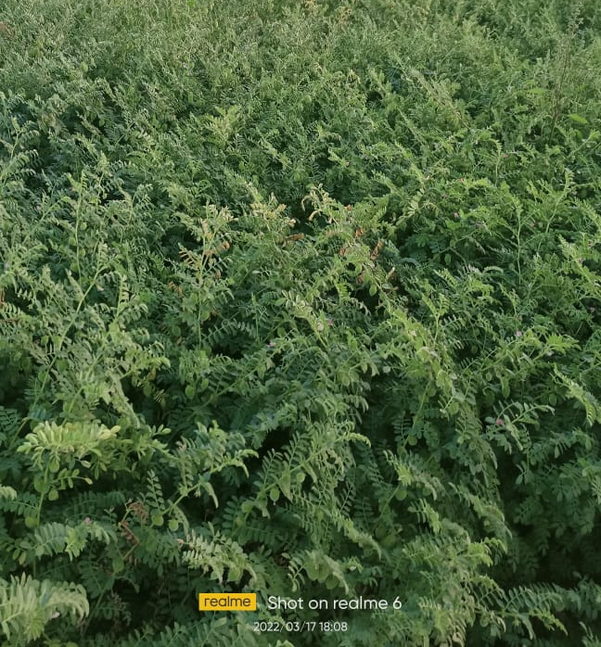
Extension activities under CFLD (Chickpea) conducted:
Field days (3) : 84 participants
Field visit (6) : 136 participants
Media coverage (2) : Not fixed
Technical feedback:-
Need for effective herbicides to control pyaji (Asphodelus tenuifolius) in gram crop
Framer’s reactions:-
Good response of the varieties and basal application of fertilizers.
Good response of trichoderma against wilt & root rot diseases

Slide 14
Cluster Front Line Demonstration in mustard (NFSM) (Rabi-2021-22)
Crop – Mustard
Variety – RH- 725
Local check – RH-8812
Area–20 ha
Demonstration-50
Crop Sequence:- Clusterbean-Mustard; Fallow–Mustard; Mungbean–Mustard; Cotton–Mustard.
Cultivation under irrigated conditions.
Soil type:- Sandy loam soil; Organic matter - 0.2 to 0.4% (Low); Phosphorus - 20 to 32 kg/ha (Medium) & Potash - 380 to 480 kg/ha (high)
Weed flora : Chenopodium album (Bathua), Chenopodium mural (Kharbathua), Asphodelus tenuifolius (Pyaji), Anagallis arvensis (Krishan neel), Convolvulus arvensis (Hirankhuri).
Major insects : Painted bug & Aphids.
Major diseases : Sclerotinia (Sclerotinia sclerotiorum)stem rot disease, White rust (Albugo candidan).
Technological package demonstrated:-
Spacing: 45 X 10-15 cm
Sowing time:- Month of October
Recommended seed rate:- 2.0 kg per hectare
Seed treatment :- Metalexil 35 SD @ 6 g per kg of seed & Imidachloprid 48% FS @ 5 ml per kg of seed
Balance use of of fertilizers: - 80 kg N₂ & 40 kg P₂O₅ per hectare (basal as well as Top dressing)
Use of bio inoculant: - NPK consortia @ 2.5 lit/ha.
Use of herbicide: - Pendimethalin 38.7% CS @ 750ml a.i. per hectare.
Use of PP measures :- Two spray of fungicide {1st spray with Redomil Gold (Metalaxyl M4 + Mancozeb 64%) @ 2gm per litre of water at 50 DAS and 2nd spray with SAAF (Carbendazim 12% + Mancozeb 63% WP) @ 2gm per litre of water at 65 DAS

Slide 15
Performance of CFLD Mustard (Rabi-2021)
State average yield : 15.81 q/h (2019-20)
District average yield : 14.33 (2019-20) q/h
Yield (q/ha) |  |  |  | % Increase in yield
High. | Min. | Av. | Local check
23.96 | 19.05 | 21.31 | 18.06 | 17.99
Sale price : Rs.6300-6600 per qtl; Sale price of straw : Rs 150 per qtl. Minimum Support Price (MSP) : Rs. 5050/- per qtl (Rabi 2021-22)
Economics
 | Demonstration Plot | Farmer's Existing Plot
Gross Cost (Rs/ha) | 29254 | 27431
Gross Return(Rs/ha) | 138515 | 117390
Net Return (Rs/ha) | 109261 | 89959
B:C Ratio | 4.73 | 4.28
Technological gap analysis of CFLDs Mustard
Number of CFLDs | Potential yield (q/ha) | Demon yield (q/ha) | Farmer Practice yield (q/ha) | % increased | Ext. Gap (q/ha) | Tech. Gap (q/ha) | Tech. Index (%)
50 | 28 | 21.31 | 18.06 | 17.99 | 3.25 | 6.69 | 23.89

Slide 16
About technology interventions
Sowing of 45 cm row spacing with suitable seed rate and use of bio inoculants & fertilizers resulted in healthy growth of plants and good production.
With proper treatment of seeds, the damage from white rust and painted bug was observed to be negligible.
Pre-emergence application of Pendimethaline 38.7% CS resulted in good control of broad-leaved weeds as well as other weeds, but the presence of a weed called Asphodelus tenuifolius (Pyaji) was observed in the fields. This weed is not being properly controlled even after using the recommended weedicides.
Farmers apply two sprays (Prophylactic) of fungicide at 50 and 65 days crop stage showed stem rot disease below ETL in those fields.
Soil treatment with Trichoderma was also effective in good seed germination and to prevent fungal diseases.

Slide 17
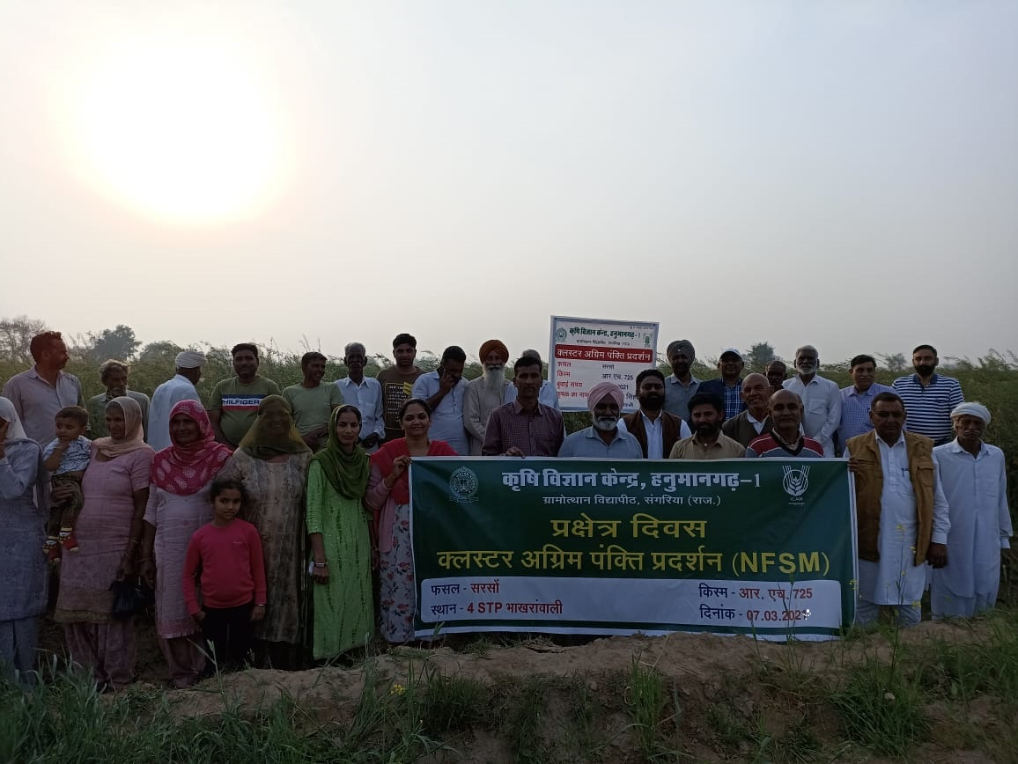
Extension and other activities under CFLD (Mustard) conducted:
Field days (5) : 158 participants
Field visit (8) : 87 participants
Trainings (1) : 36 participants
Media coverage (4) : Not fixed
Framer’s reactions:-.
Farmers were satisfied with the performance of RH-725 variety of mustard in reference of seed yield..
Good response of basal application of fertilizers.
Technical feedback:-.
Development of frost resistant bold seeded varieties of mustard.
Need for research on planting space in mustard crop.
Strong strategies should be developed for Sclerotinia stem rot disease in mustard.
Evaluation of some effective herbicides to control of weeds in mustard.

Slide 18
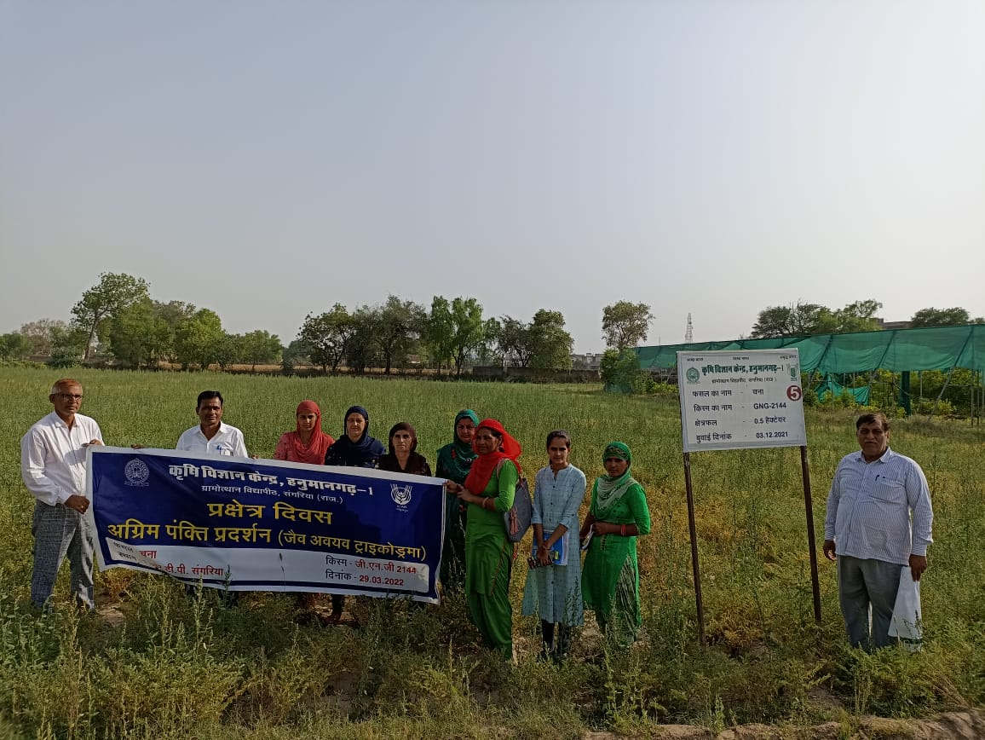
FLD on Trichoderma in Chickpea (Rabi-2020-21)
Area : 4 hectare
No. of Demonstration : 10
Variety – GNG 1581
State average yield (2019-20) : 10.80 q/h
District average yield (2019-20) : 6.27 q/h
Yield (q/ha) |  |  |  | % Increase in yield
High. | Min. | Av. | Local check
14.80 | 14.25 | 14.56 | 12.49 | 16.57
Note:- Sale price: Rs.4700 -5000/- quintal
MSP : Rs. 5100/- quintal (Rabi 2020-21)
Economics
 | Demonstration Plot | Farmer's Existing Plot
Gross Cost (Rs/ha) | 29971 | 28471
Gross Return(Rs./ha.) | 92950 | 82250
Net Return (Rs./ha.) | 62979 | 53779
B:C Ratio | 3.10 | 2.90
feedback:- Trichoderma is easily available in market. Farmers can be preparing at own farm.

Slide 19
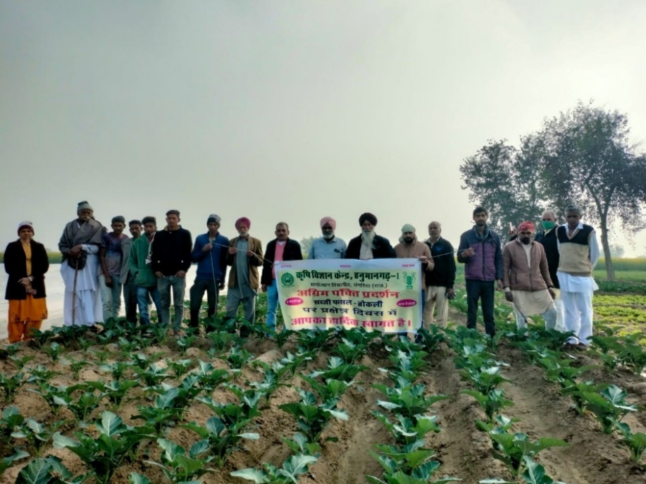
FLD on Broccoli (Rabi-2021-22)
Area : 0.5 hectare
No. of Demonstration : 10
Variety – Green magic
Yield (q/ha)
High. | Min. | Av.
182.0 | 132.5 | 155.9
Note:- Sale price of broccoli: Rs.1600-1800/- quintal
Economics
 | Demonstration Plot
Gross Cost (Rs/ha) | 68954
Gross Return(Rs./ha.) | 427860
Net Return (Rs./ha.) | 358906
B:C Ratio | 6.20
feedback:- Broccoli is a high value crop and is rich source of nutrients. It gave higher net return as compere to other vegetable crops. In this year, yield of Broccoli gradually decreased due to higher temperature with low humidity harvesting stage.

Slide 20
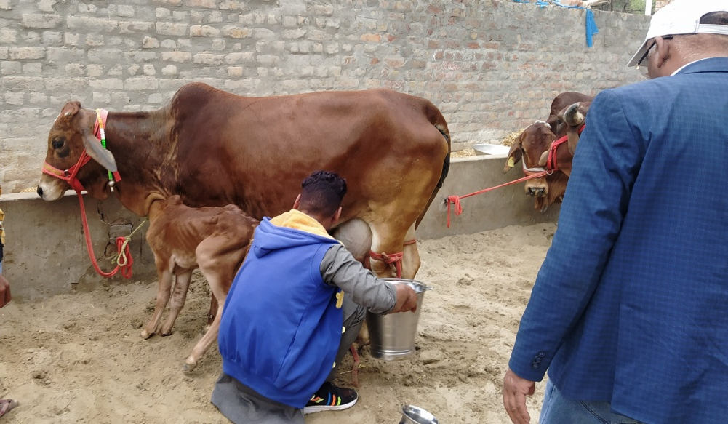
FLD on Use of by-pass protein with mineral mixture - 2022
No. of Demon. : 10
Animal – cross bred cow (10)
Milk Yield (lit./day) |  |  |  | % Increase in yield
Animals under demonstration |  |  | Local check animals
High. | Min. | Av. | Av.
14.5 | 9.7 | 12.08 | 10.56 | 14.4
Economics
 | Demonstration | Farmer's practice
Gross Cost (Rs/ha) | 208.0 | 176.5
Gross Return(Rs./ha.) | 422.8 | 295.7
Net Return (Rs./ha.) | 214.8 | 119.18
B:C Ratio | 2.03 | 1.68
Technical feedback:- Average milk production increased with Fat% and SNF% as compare to normal feeding of animal. Milk sale price is also increased at milk collection center from 28 Rs/lit to 35.00 Rs/lit. Animal health condition also improved.
Framer’s reactions:- Farmer’s were satisfied feeding by pass protein with mineral mixture in terms of milk density and sale price.

Slide 21
FLD on Anestrous in lactating buffaloes - 2022
No. of Demonstrations : 50
No. of Buffaloes -50
Treatment given for Anestrous | No. of animals comes in heat & conceived
Mineral Mixture@ 50g bd + Cu & Co tablets. (local check) | 12 Animals conceived out of 50
Mineral mixture @ 50 g bd + Cu & Co tablets + deworming of Animals. (Demonstration) | 38 Animals conceived out of 50
Results:- Result shows that 38 animals conceived out of 50 animals treated with mineral mixture, Cu & Co tablets and deworming.
Technical feedback:- Result shows that mineral mixture and Cu + Co tablets is required for reproduction in buffalo but presence of internal parasites reduces absorption of minerals and nutrient loss in animal body that leads to temporary infertility .
Framer’s reactions:- Animals treated with Mineral Mixture and Cu & Co tablets with de-worming; animals show heat signs and have least reproductive problems..

Slide 22
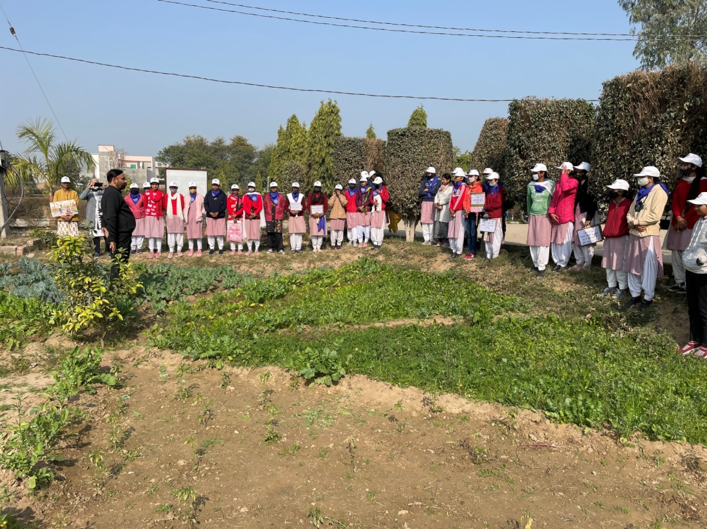
FLD on Other Enterprise : Kitchen Gardening (2021-22)
Nutritional Kitchen gardening (Area : 150 sqm)
Local check : 2 or 3 vegetables only
No. of units : 40 Duration : one year
Average Yield (Kg) |  | % change in yield | Other parameters (Availability of fresh vegetables)
Demo | Local check |  | Demo | Local
206.8 | 98.3 | 110.38 | Maximum | Least
Economics
 | Demonstration Plot | Farmer's Existing Plot
Gross Cost (Rs) | 917 | 432
Gross Return (Rs) | 7058 | 2169
Net Return (Rs) | 6141 | 1737
B:C Ratio | 7.69 | 5.02
Farmers’ reactions:- Kitchen gardening improve health, save money, maximum use of space in backyard and even wonderful activity for relive stress. Availability of fresh and chemical free vegetables. Improvement in dietary intake and nutritional status.

Slide 23
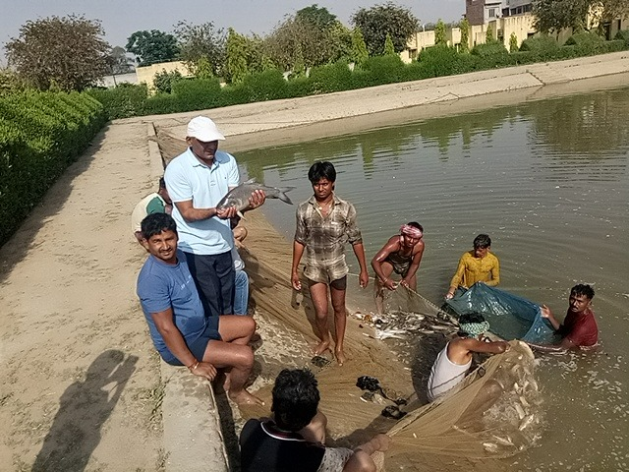
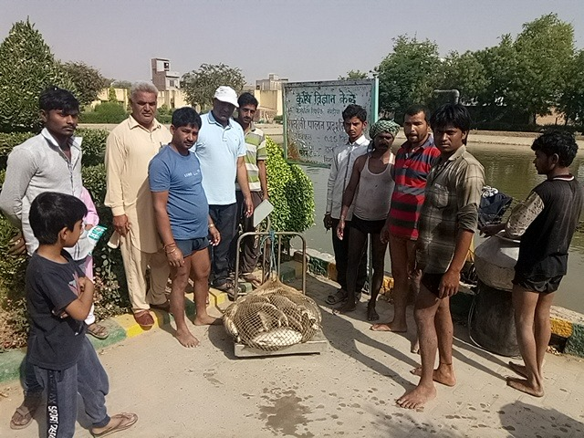
Results of Frontline Demonstration:
Enterprises : Fish culture
Year : 2020-21
Fish species : Catla, Rohu & mrigal
Stage of seed : Fingerlings (3000)
No. of Demonstration : 10
Area per unit : 0.20 ha.
Time of seed releasing : September 2020
Harvesting Time : August 2021
Average production per unit : 1040 kg.
Economics {per unit (0.20ha.)}:
Cost of cultivation : Rs. 42,700
Gross income : Rs 1,14,400
Net profit : Rs. 71,700
B:C ratio : 2.68
Sale price : Rs 110 per kg

Slide 24
Feedback for policy makers
More number of diggies can be constructed on the farmers' fields under subsidy programme. So that farmer can protect their crops during canal closure and water scarcity.
To popularize the Drip and Sprinkler irrigation system for water management.
To promote the protected cultivation and establishment of new orchards by providing subsidy to farmers.
Attractive rates of milk should be ensured to encourage dairy business.
Ensure availability of pregnancy diagnostic kit for animals.
The seeds of public sector vegetable varieties are not available to the farmers, so the availability of these seeds should be ensured.

Slide 25
Feedback for researchers
Development of frost resistant bold seeded mustard varieties.
Need for research on planting space in mustard crop.
Strong strategies should be developed for sclerotinia stem rot disease in mustard.
Evaluation of some effective herbicides to control of weeds in mustard and gram.
Need for research on phyllody resistant variety of sesame.
Yellow mosaic resistant variety need to develop.
Need of research on bio pesticides to control white fly & pod borer.
Need of strategy for Parawilt management in cotton.
Strong strategies should be developed to control of Phytopthora in citrus and fruit dropping.

Slide 26
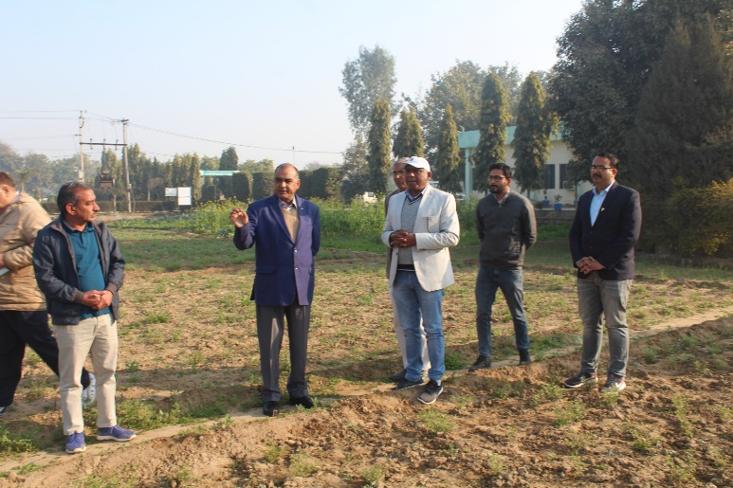
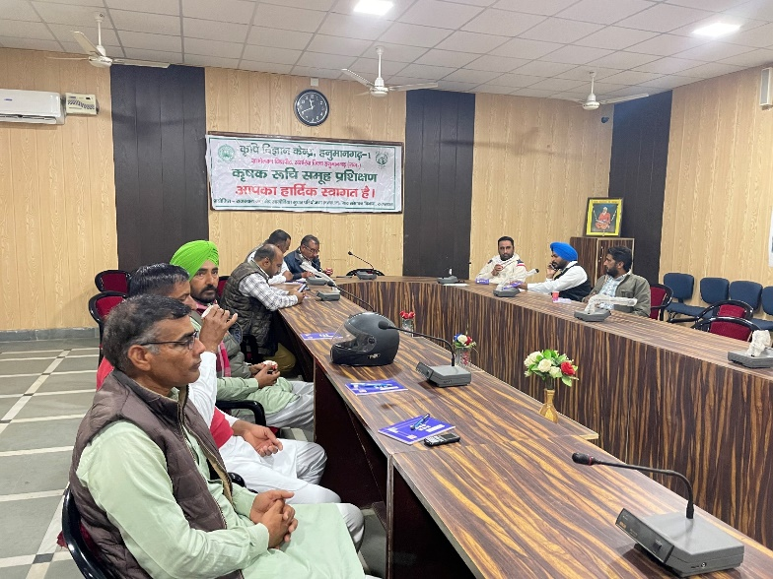
Feedback for Development Department
Demonstrations and awareness programmes should be conducted on Bio fortified varieties.
Gear up the seed production of bio fortified varieties.
Refresher courses should be organized for field staff. So that their knowledge can be updated about new technologies.

