Slide 1


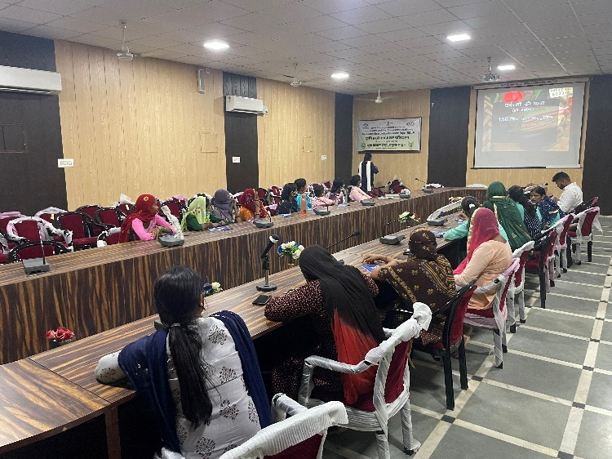
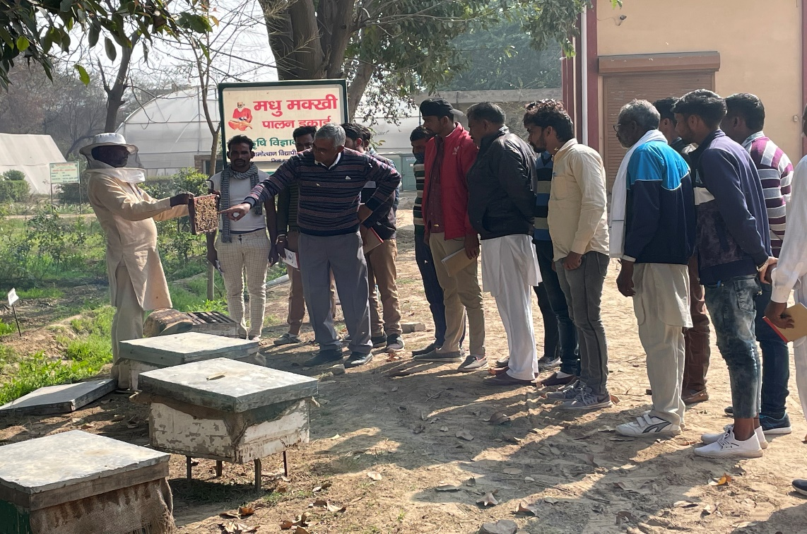
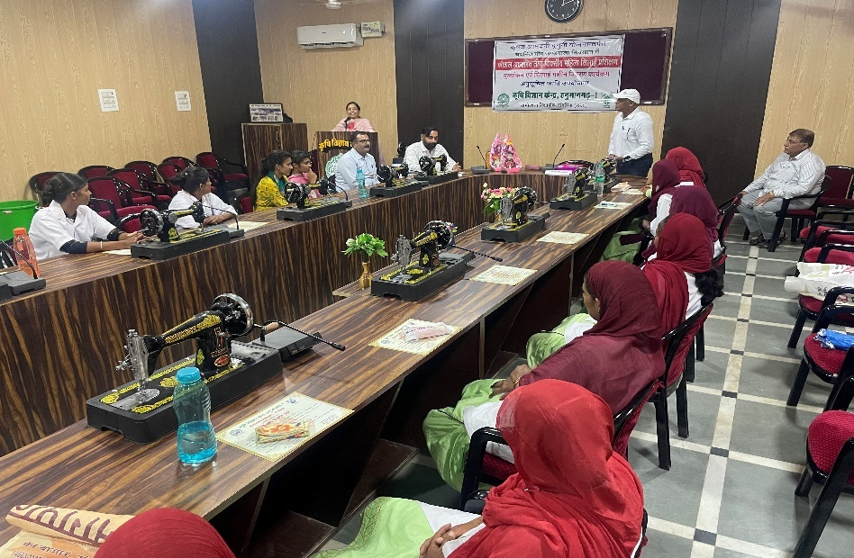
Training programmes conducted during 2021-22
For farmers/Farm women
S.No. | Discipline | No. of training programmes | No. of training participants
 |  |  | Male | Female | Total
1. | Crop production | 06 | 225 | 34 | 259
2. | Horticulture | 05 | 98 | 67 | 165
3. | Plant protection | 07 | 257 | 14 | 271
4. | Animal Science | 05 | 177 | 22 | 199
5. | Fisheries Science | 04 | 182 | 12 | 194
6. | Extension Education | 05 | 150 | 11 | 161
 | Total | 32 | 1089 | 160 | 1249

Slide 2
Training programmes conducted during 2021-22
For Rural Youth
S.No. | Area of training | No. of courses | No. of training participants
 |  |  | Male | Female | Total
1. | Bee-keeping | 01 | 35 | 0 | 35
2. | Sheep and goat rearing | 01 | 23 | 14 | 37
3. | INM | 01 | 35 | 0 | 35
4. | Bio agent production | 01 | 30 | 0 | 30
5. | Tailoring & stitching | 02 | 0 | 52 | 52
 | Total | 06 | 123 | 66 | 189
For Extension personals
S.No. | Area of training | No. of courses | No. of training participants
 |  |  | Male | Female | Total
1. | Productivity enhancement in field crops | 3 | 67 | 21 | 88
2. | Group Dynamics and farmers organization | 2 | 57 | 12 | 69
 | Total | 05 | 124 | 33 | 157

Slide 3
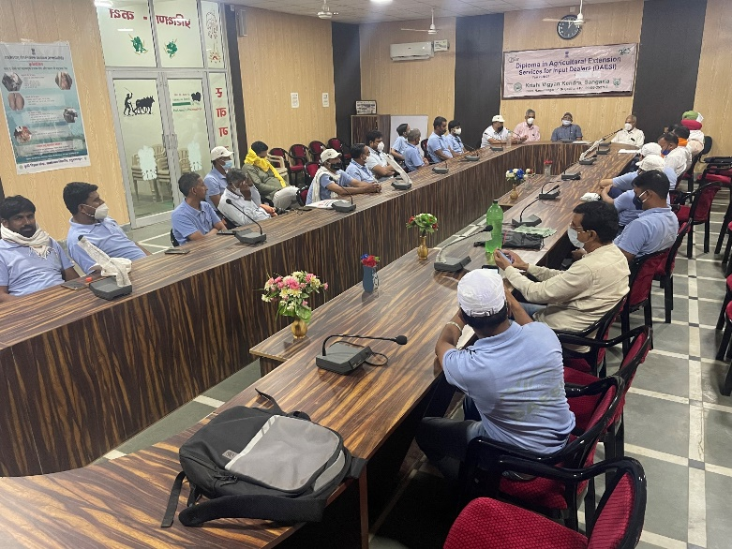
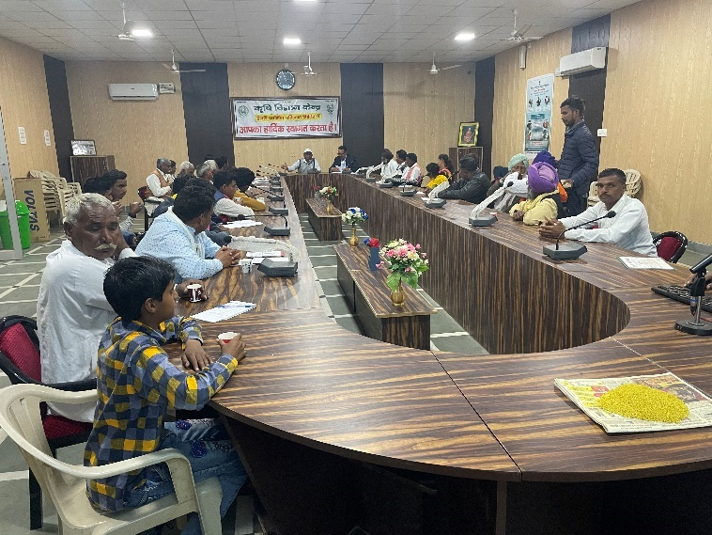
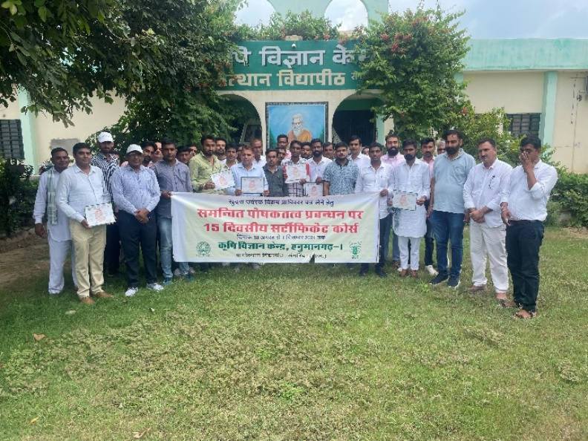
Sponsored Training Programme 2021-22
For farmers/farm women/rural youth
S. No. | Area of training | Duration (days) | No. of participants |  |  | Sponsoring agency
 |  |  | Male | Female | Total
1. | Krishi Sakhi & ARP | 4 | 0 | 16 | 16 | RWSLIP, Jaipur
2. | Integrated Fish Farming | 1 | 28 | 2 | 30 | MANAGE, Hyderabad
3. | Integrated Fish Farming | 5 | 24 | 6 | 30 | MANAGE, Hyderabad
4. | Integrated Fish Farming | 1 | 9 | 11 | 20 | MANAGE, Hyderabad
5. | Aquaculture as livelihood technology | 2 | 27 | 0 | 27 | ICAR-CIFA, Rohatak
 | Total | - | 88 | 35 | 123

Slide 4


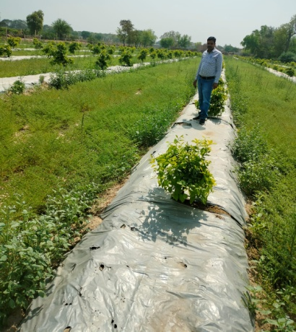
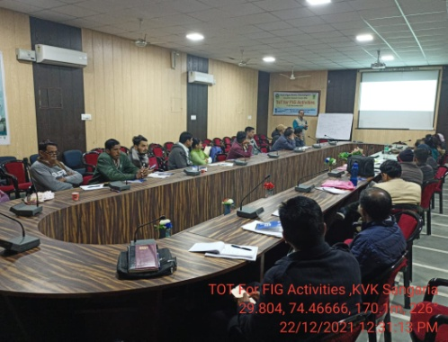
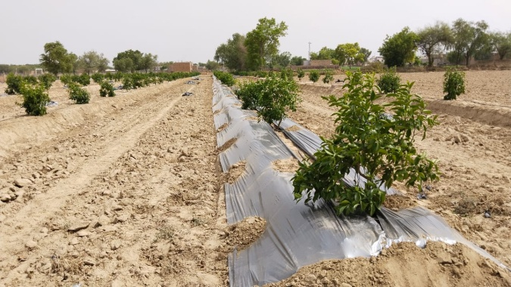
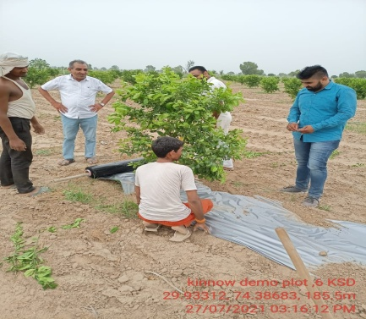
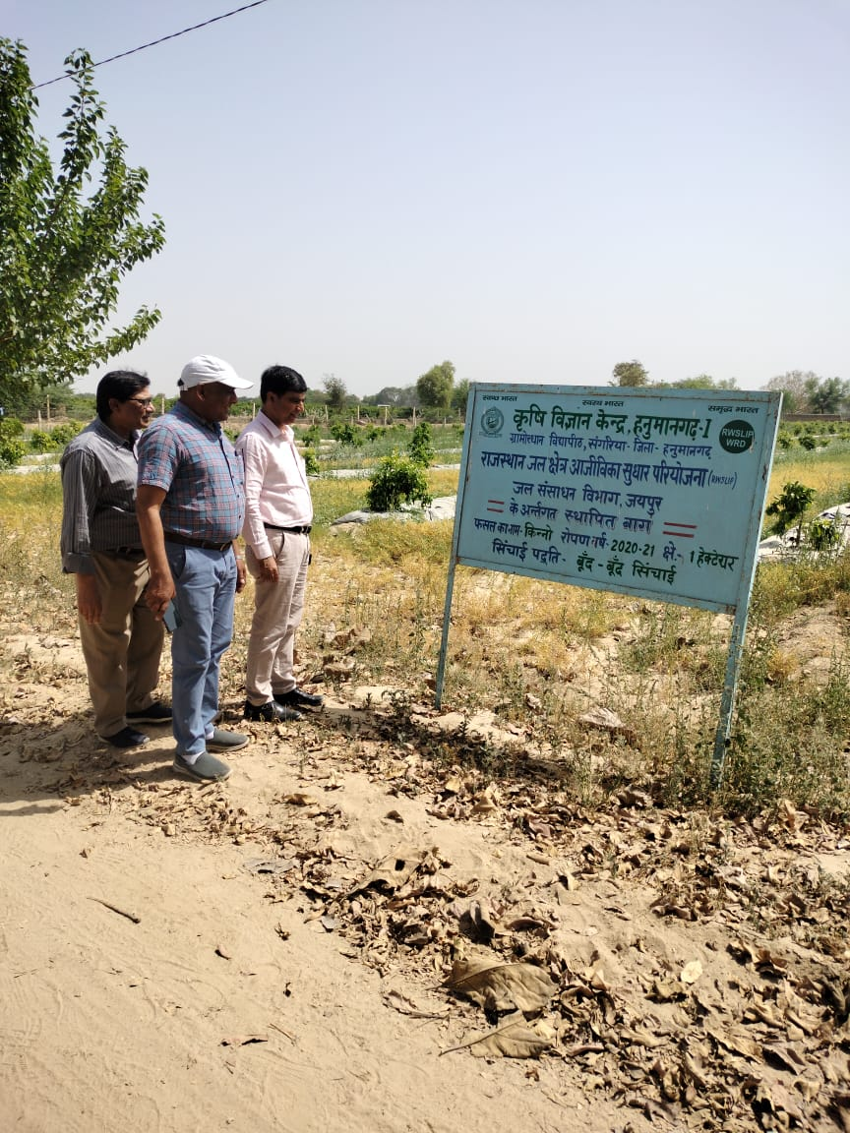
Rajasthan Water Sector Livelihood Improvement Project (RWSLIP)
(2021-22)
S. No. | Training programme | Duration (days) | No. of participants
1 | TOT for FIG | 2 | 30
2 | TOT for specific cultivation techniques on kinnow | 2 | 32
3 | TOT for technical field staff & women wing representative for gender mainstreaming | 2 | 35
4 | Training for FIG members | 1 | 9
 | TOTAL |  | 106
Major activities - Raise bed (3.5 x 2 feet) plantation - use of poly mulch
Demonstration (Kinnow orchard) at Farmer’s field
Area : 1 ha.
Name of farmer : Sh. Jasvinder Singh S/o Sh. Mewa Singh, Dholnagar (Raj.)
Establishment of Orchard : 2020-21
Demonstration (Kinnow orchard) at KVK – 1 ha.

Slide 5
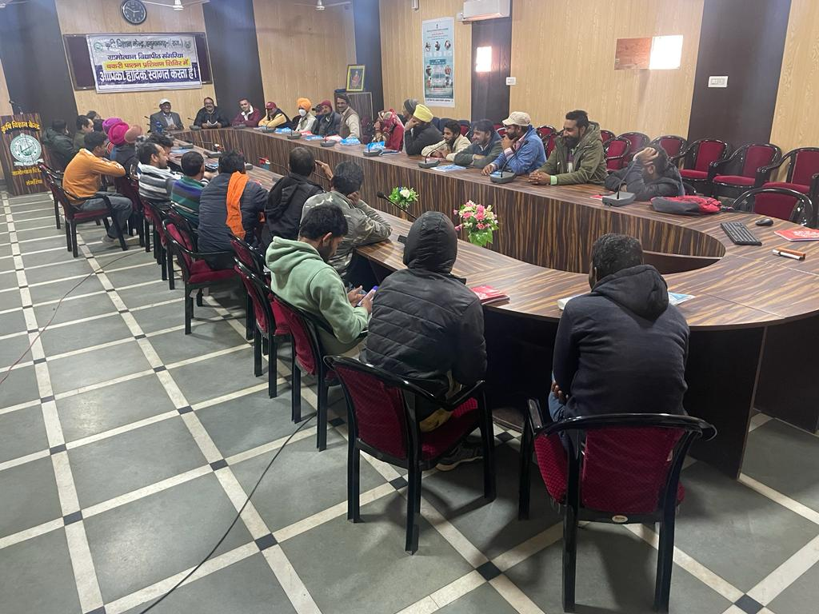
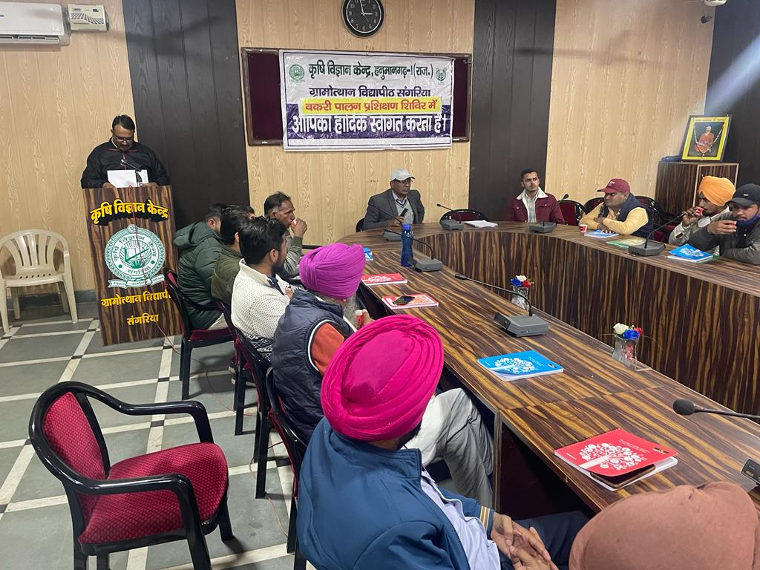
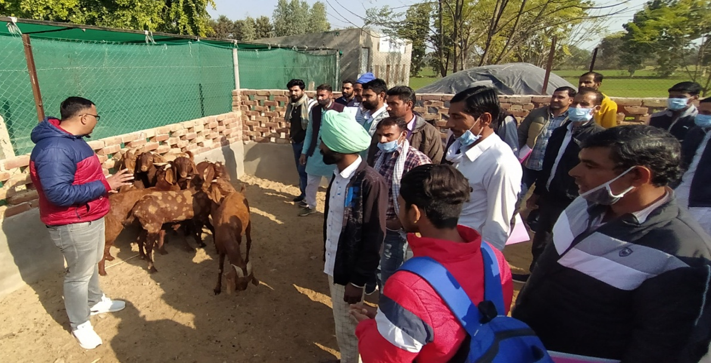
Capacity building programmes on Livestock management under MFD&AH (2021-22)
S. No. | Training programme | Duration (days) | No. of participants
1 | Care & management in Goat farming | 3 | 40
2 | Breeding management in dairy animals | 3 | 31
3 | Disease management in Goat farming | 3 | 49
4 | Care & management in Poultry farming | 3 | 40
 | TOTAL | - | 160

Slide 6

SEED PRODUCTION AT KVK
S. No. | Crop | Varieties | Quantity (Q)
1 | Wheat | HD-3117, HD-3086, HD-3226 | 86.00
2 | Chickpea | GNG-2171 | 09.60
3 | Mustard | RH 0749 & RH-725 | 10.90
4 | Til | RT-351 | 0.31
5 | Moong | MH-421 | 2.20
Provided seed to farmers : 294
Amount : Rs. 5.00 lacs
STATUS REVOLVING FUND
Year | Opening balance as on 1st April | Income during the year | Expenditure during the year | Net balance in hand as on 1st April of each year
2018-19 | 2301576.12 | 4214994.77 | 3927079.78 | 2566978.31
2019-20 | 2566978.31 | 4842108.09 | 2744539.29 | 4510892.36
2020-21 | 4510892.36 | 5009066.50 | 3520336.10 | 5791236.12
2021-22 | 5791236.17 | 6593674.98 | 4099745.36 | 8467225.13

Slide 7
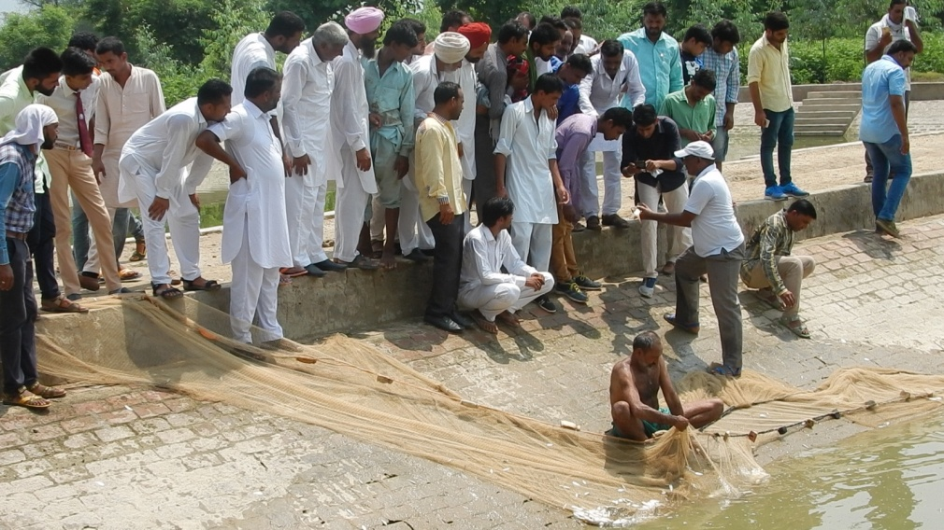
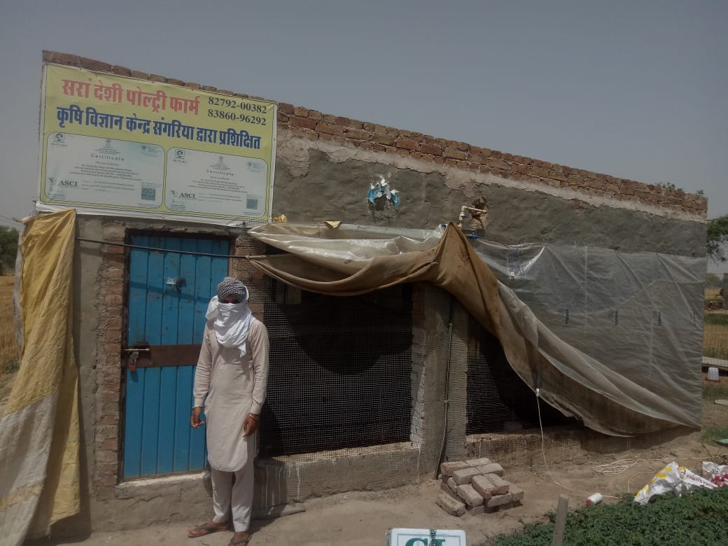
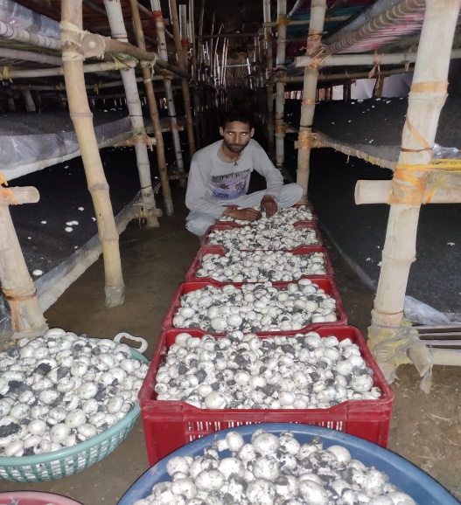
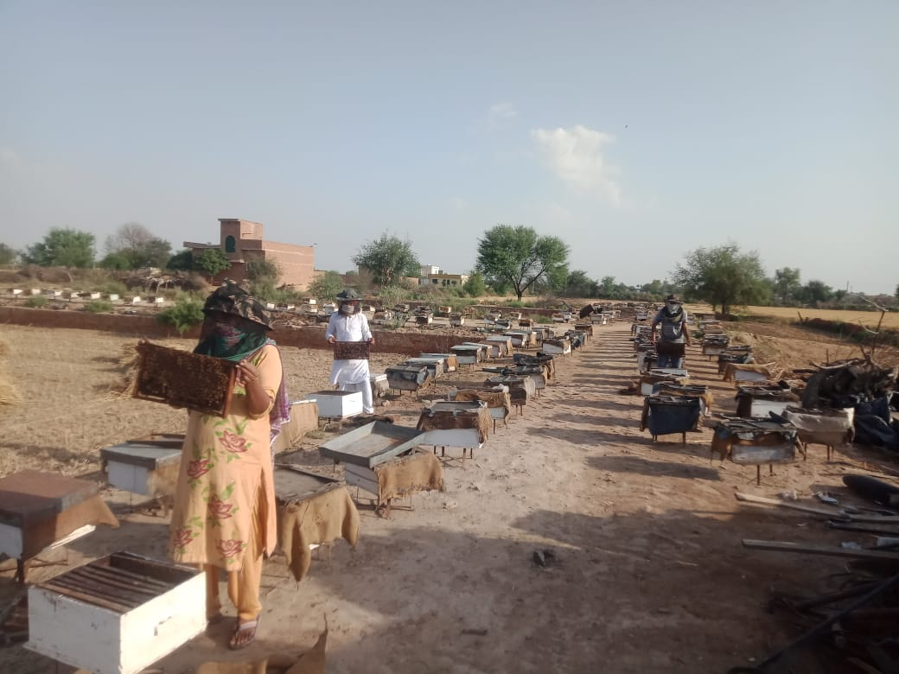
PARTICIPATORY IMPACT ASSESSMENT (2016-2021)

Slide 8
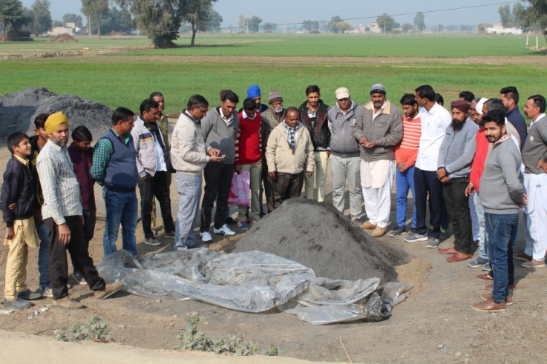
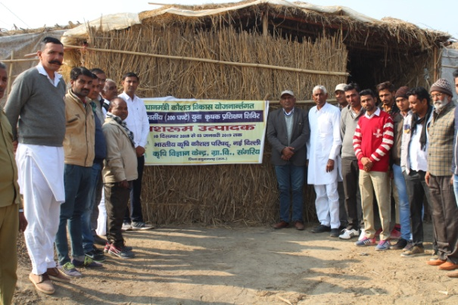
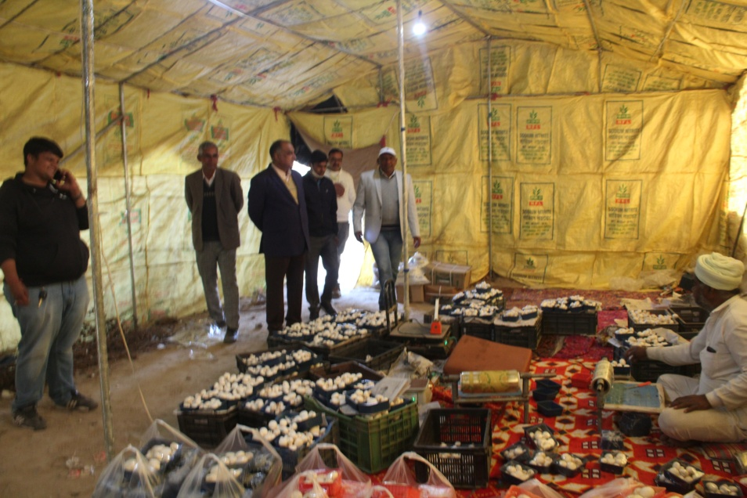
TRAINING IMPACT ON MUSHROOM CULTIVATION
Total Training - 12
Participants 448
Establish
unit 51
IMPACT
Avg. Production capacity = 0.88 MT./ Unit
Avg. Annual Income = 52800 INR/Unit
Mushroom Produced = 45.76 MT in district Contribution in district economy -27.46 Lac

Slide 9

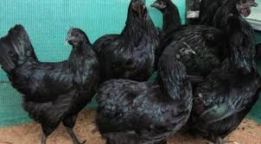
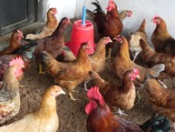
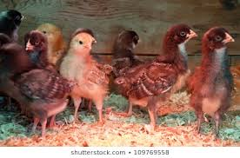
TRAINING IMPACT ON POULTRY FARMING
Total Capacity building programme-4
Introduced breeds by KVK
Kadaknath
Pratapdhan
Establish
unit 34
Participants 112
IMPACT
Rhode Island Red
Low egg production 80-100 eggs
Slow growth
Desi Breeds
Average birds/unit -135 Birds
Average egg production 150-220
better growth & quality meat gain
Improved Breeds
Avg. egg Production-803250 and 236.5kg meat
Contribution in district economy -80.65 Lakhs/Year

Slide 10
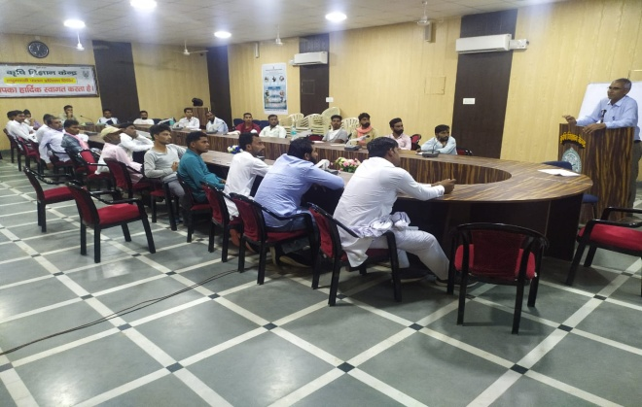
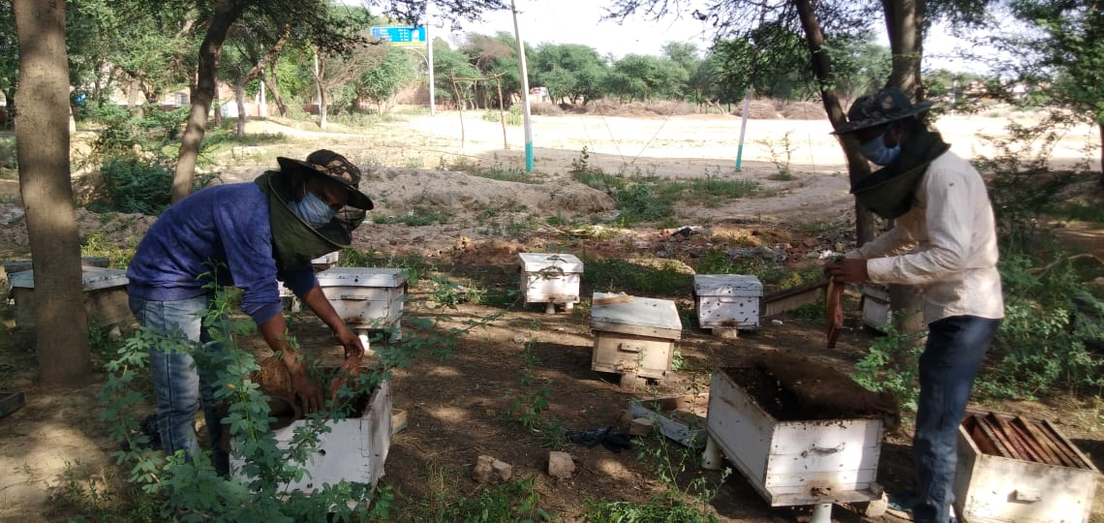
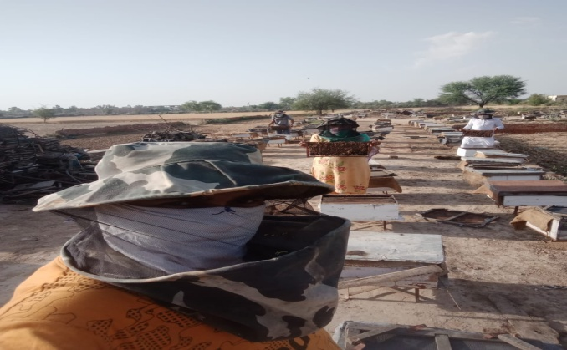
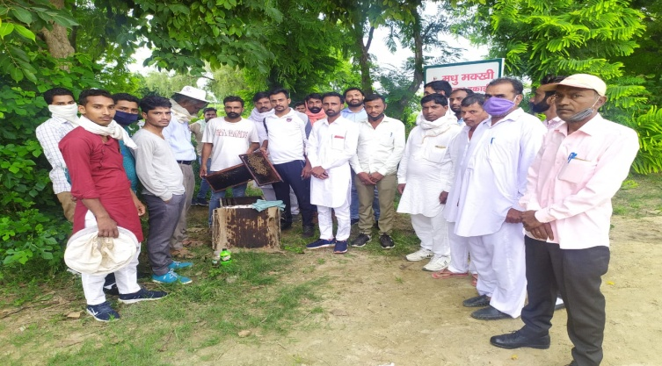
TRAINING IMPACT ON BEEKEEPING
Total Capacity building programme-7
Participants 295
IMPACT
Establish
unit 69
Average Box Per Unit- 50
Honey production 51.60 MT/Yr.
Annual Bee colonies increase 30%
Mustard pollen production 17.5 MT/Yr.
Per box Income - Rs. 3500
Contribution in district economy -3.75 Crores

Slide 11
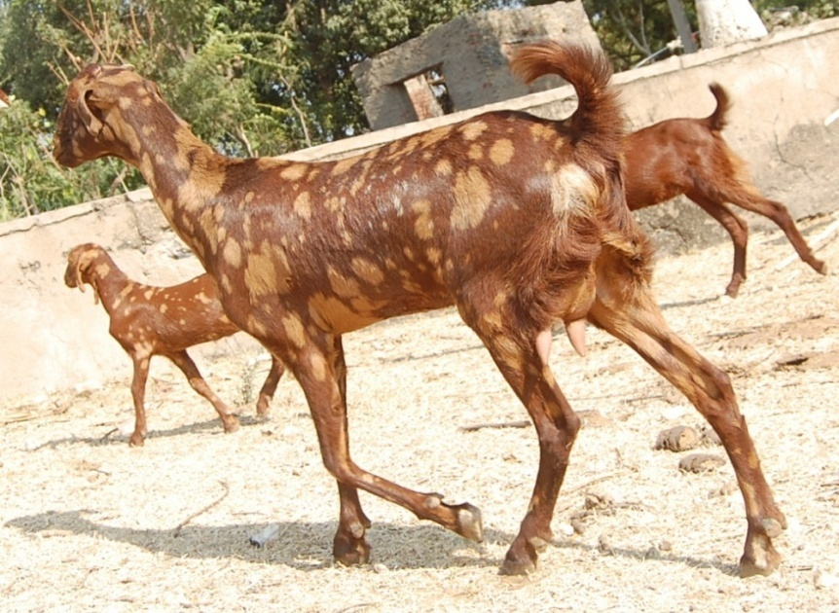
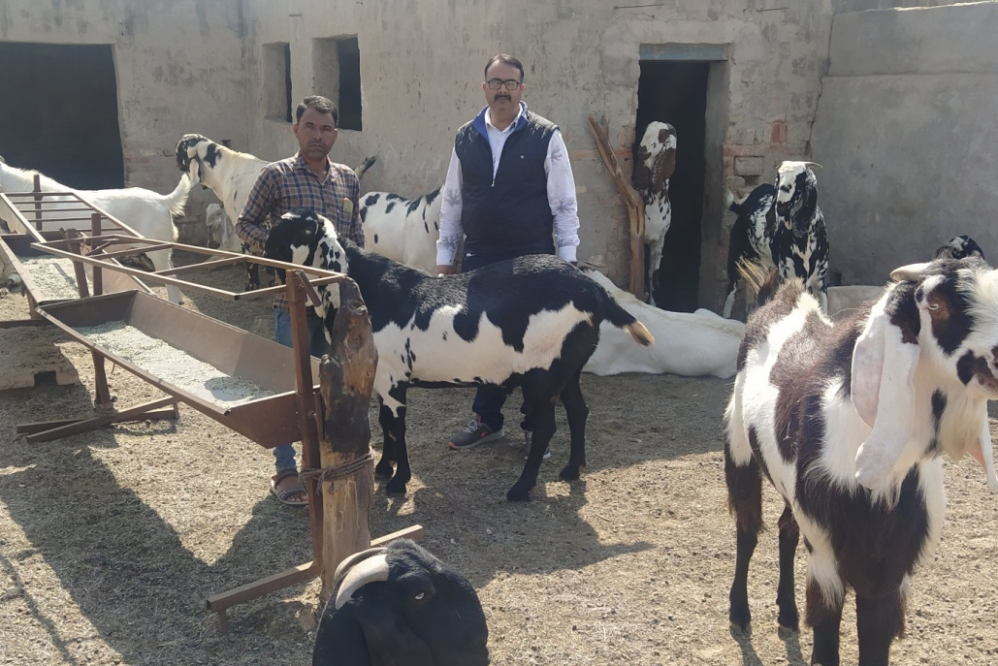
TRAINING IMPACT ON GOAT FARMING
Total Capacity building programme-9
Raising of castrated male promoted by KVK
IMPACT
Establish
unit 42
Participants 357
Avg. Herd size- 47 nos.
Annual net income per unit-98000 /Yr.
Contribution in district economy- 41.11 lakhs

Slide 12
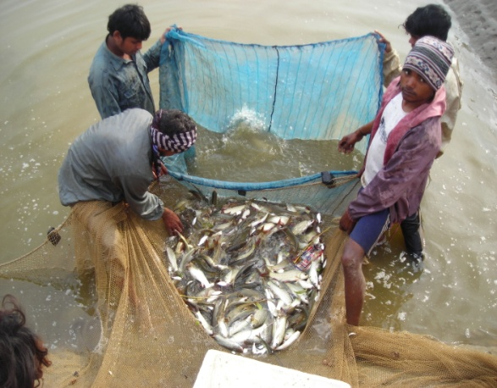
TRAINING IMPACT ON FISH FARMING
Total Capacity building programme-11
Establish
unit 114
Participants 290
IMPACT
Per Unit Average income- 36800 INR
(Unit Size = Pond -100’x100’x10’)
Contribution in district economy 36.25 Lakhs/Year

Slide 13
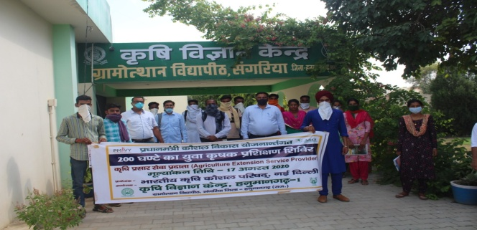
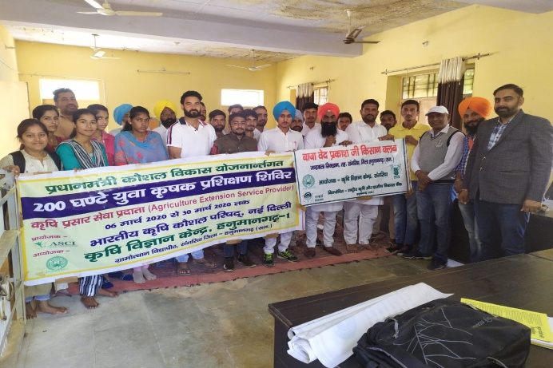
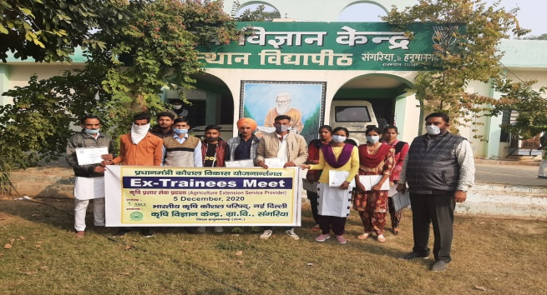
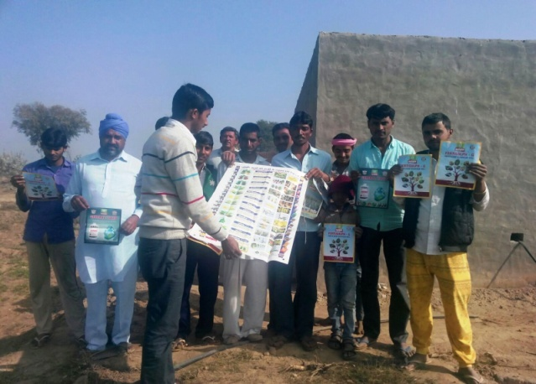
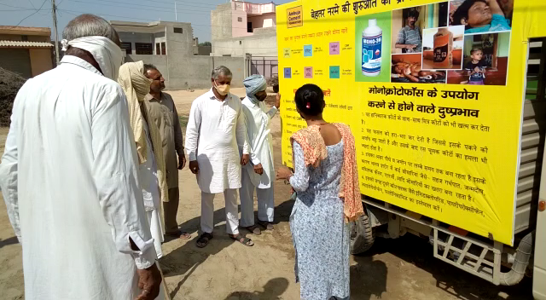
TRAINING IMPACT ON EXTENSION SERVICE PROVIDER (ASCI)
Total Capacity building programme-2
Participants 45
IMPACT
Employed 24
S.No. | Participants Employed | Monthly Income (Rs) | Employment Agency
1 | 2 | 10000-11000 | Sonal Seeds
2 | 19 | 13000-18000 | Ambuja cement Foundation, Sonal Seeds, Karnatka Agro Chemical, T-stains
3 | 3 | 19000-22000 | Sri Ram seeds, Syngenta, T.Stains

