Slide 1
KRISHI VIGYAN KENDRA, HANUMANGARH-I
Annual Progress Report
(2021-22)
Dr. Anoop Kumar
Senior Scientist & Head
GRAMOTTHAN VIDHYAPEETH,
SANGARIA (Raj.)

Slide 2
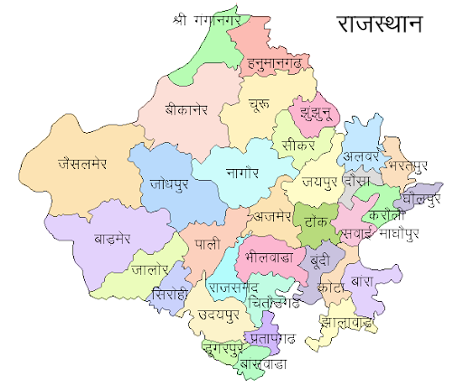
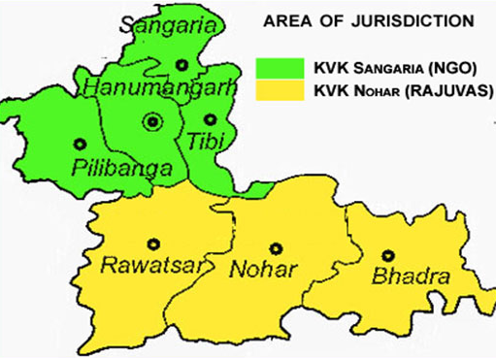
DISTRICT PROFILE OF hANUMANGARH
Agro-Climatic Zone of Rajasthan =IB
Geographical area = 9,70,315 ha (3,62,621 ha)
Cultivated area = 8,86,000 ha (2,98,565 ha)
Irrigated area = 3,74,357 ha (2,62,256 ha)
Rainfed area = 5,11,643 ha (63,346 ha)
Average rainfall = 250-300 mm
Soil type = Sandy Loam to loamy sand
Average temperature = Maximum 48⁰C and Minimum 02⁰C
Farming system = Agriculture/Animal Husbandry/ Horticulture/Fisheries/Poultry
Kharif crops= Cotton, Paddy, Clusterbean, Mungbean, Groundnut and Sesamum.
Rabi crops= Wheat, Mustard, Chickpea, Barley and Tarameera.
Major problems
1. Poor quality of under ground water. 2. Soil erosion and low soil fertility. 3. Short-term/long-term drought due to untimely, inadequate and uneven distribution of rainfall.
Positive points= Large holdings per farmer. Adequate availability of canal water for irrigation. Soil is suitable for cultivation of Cotton, Paddy, Wheat, Barley, Chickpea, Mustard, Kinnow etc. Adequate availability of improved agricultural equipments. Regular and balanced supply of agricultural inputs

Slide 3
Weather impact on crops
Dry spell in August:-
Due to high temperature and no rains in the month of August for district, Kharif crops suffered a lot. These days cotton crop was at flowering and boll formation stage, in which flower dropping observed. Moong and Guar crops were also at flowering and pod formation stages. The process of pod formation was interrupted due to high temperature and drought conditions.
Moderate to heavy rainfall observed:-
In the months of September and October, moderate to heavy rainfall was recorded at isolated places in the district. The crops were in maturity and harvesting stage. So, the quality of crop produce was affected and yield decreased.
Frost and cold wave:-
6 days in December, 5 days in January and 2 days in February the temperature was less than 4⁰C and cold wave conditions were observed. Due to low temperature and high humidity, infestation of pest & diseases and cold injury of plants were observed.
Heat wave:-
The last week of March and the April the heat wave condition and high temperature (Above normal) observed and a lot of damage to the crops, especially in the gram and wheat crops. Pre-maturity was observed in the crops. With the drying up of crops, production also decreased.

Slide 4
District Agromet Unit – Sangaria (Estd. Aug. 2019) (India meteorological Department) (Initiative of IMD & ICAR)
Sh. Pradip Kumar | SMS (Agromet) | 9461111006 | pradeepbhakar94611@gmail.com
Sh. Niraj Kumar | Observer | 8875009898 | nikssinghal1@gmail.com
Advisory is Prepared for all 7 blocks
Total Advisory- 106
Special advisory-2 (Cyclone Tauktae, Frost & cold wave ) General advisory-104
No. of FAP organised- 14; Total benefited farmers- 270
Total SMS on M-kisan- 7; Total benefited through M-kisan farmers- 70779
Total No. of WhatsApp group- 70 (Farmers – 12611)
Facebook group- 6200
No. of village covered- 1913

Slide 5
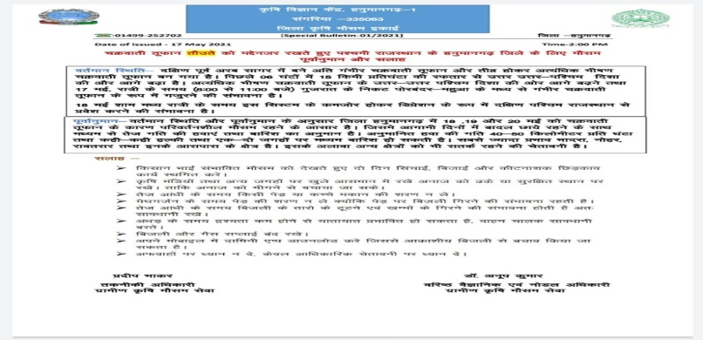
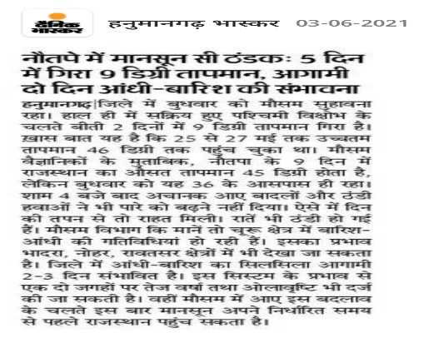
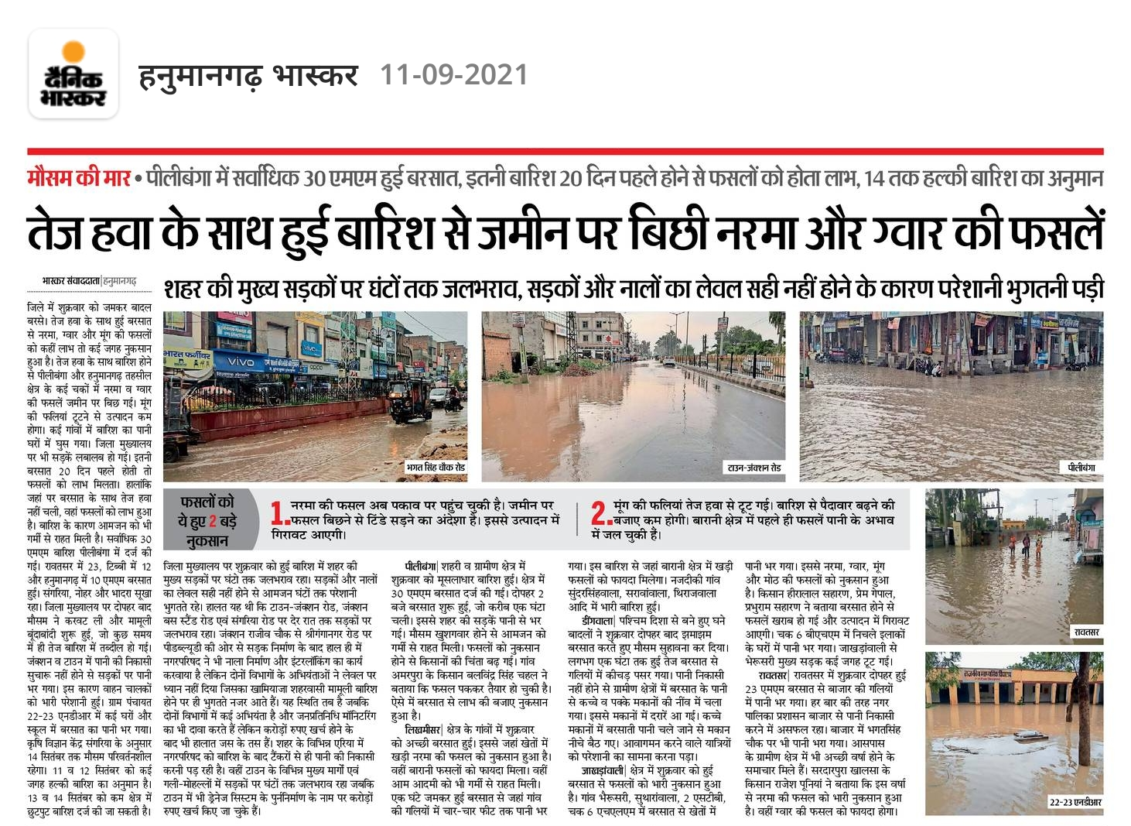
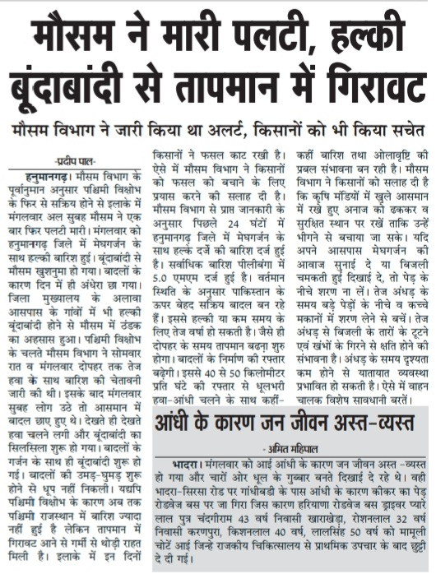
Status of media coverage/Articles/Paper published
Advisory published in local Newspaper – 56 TV/ Radio broadcast - 01 | Folders published – 01 Articles published -03 | Research paper published - 01

Slide 6
